Slide 1
Hormones
Estrogens.
Androgen.
Progestins.
Glucocorticoids
5.Mineralocorticoids

Slide 2
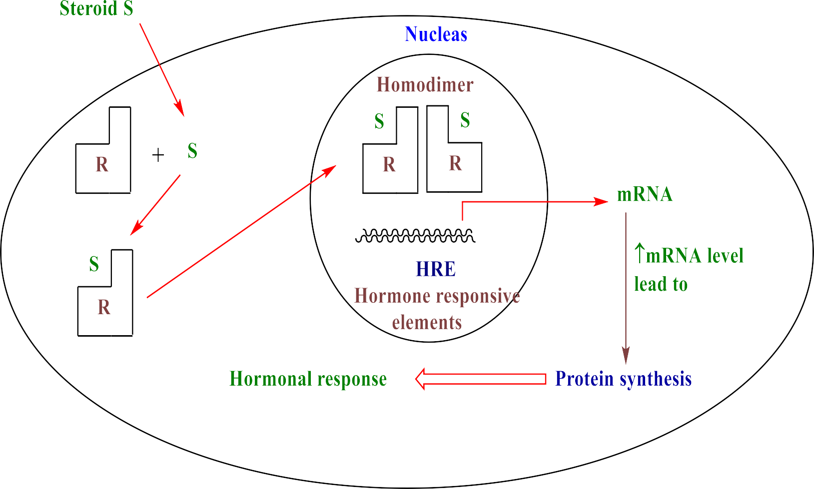

Slide 3









Thus, some neoplasms are:-
Hormone dependent and responsive to hormone-based therapy.
Hormone independent and unresponsive.
Hormonal effect in breast cancer:-

Slide 4


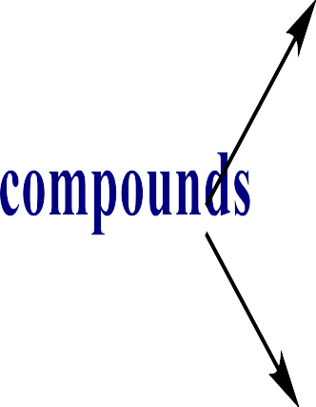










Slide 5




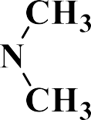
Estrogen inhibitor - Tamoxifen citrate•
Tamoxifen is a nonsteroidal agent.
It has potent antiestrogenic properties.
Exert its antitumor effects by binding to estrogen receptors. This binding causes a conformational change that decreases DNA transcription.
It is cell cycle specific for the mid-G2 phase.
Uses:- Tamoxifen is useful in the palliative treatment of advanced breast cancer in women.

Slide 6



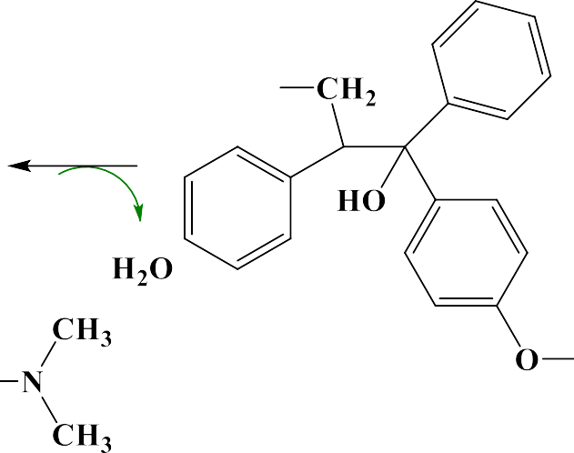





Preparation:-

Slide 7





- Aromatase inhibitor

Slide 8
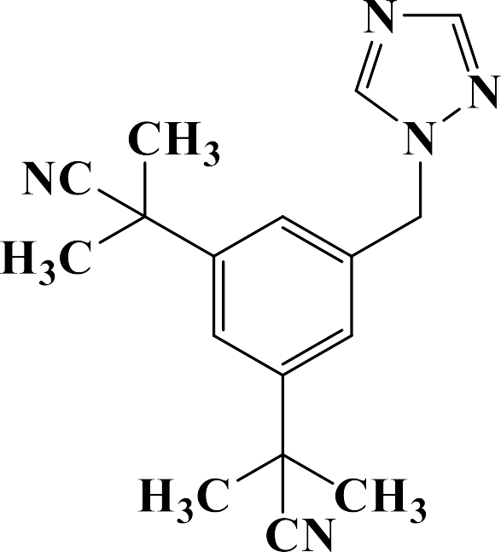







Nonsteroidal aromatase inhibitors (Triazole derivatives)•
Examples

Slide 9








steroidal aromatase inhibitors they are all derivatives of • androstenedione that act as a false substrate and binding irreversibly to the active site of this enzyme.
Exemestane
Uses:- used for treatment of post –menopausal women with hormone dependent breast cancer.

Slide 10
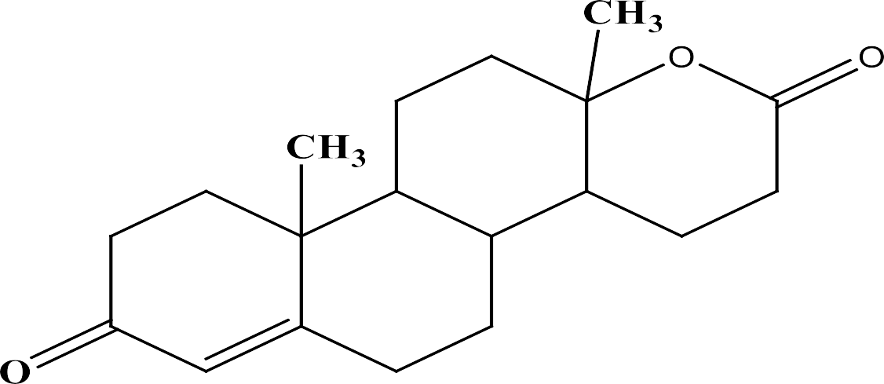

Androgens are active against metastatic breast cancer in postmenopausal women.
Testosterone propionate is the androgen most frequently used
against breast cancer.
2α-methyltestosterone.
Fluoxymesterone.
19-nor-17α-methyltestosterone.
Testolactone is preferred in some cases because it has no androgenic side effects.

Slide 11
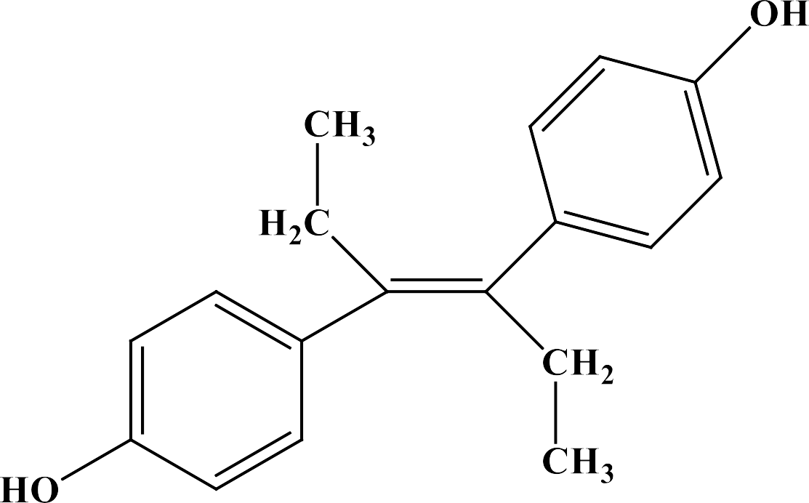


Prostate cancer
Synthetic estrogen
Diethylstilbestrol is the compound most widely used for advanced prostate cancer

Slide 12
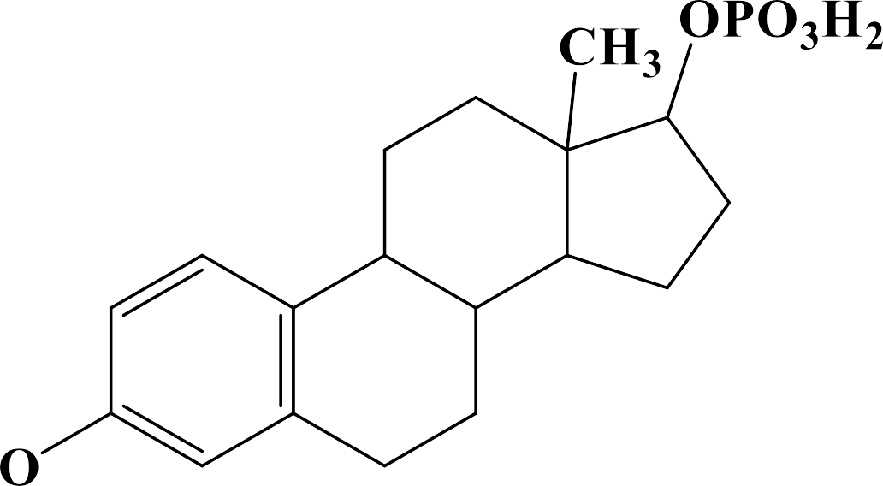












Androgen antagonist•
Estramustine phosphate(steroidal agent)

Slide 13


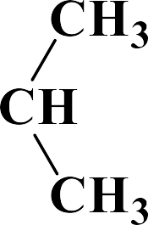




The amide derivatives of trifluoromethyl aniline( • non steroidal) have been approved for use in combination therapy of prostate cancer. They are:-
Flutamide.
Nilutamide.
bicalutamide.
Flutamide

Slide 14
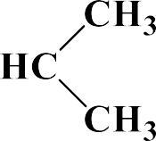


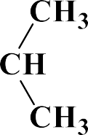

Preparation
Uses:- These compounds bind to cytosolic androgen receptors and block the effects of testosterone and other androgen.
S/E:- The most common side effects are gynecomastia and nipple pain.

Slide 15





Progesterone
Glucocorticoids and adrenocorticotropic hormone(ACTH)
Mitotane

